Slide 1
Teachable machine learning
Mateusz Mierzejek
15/12/2022

Slide 2
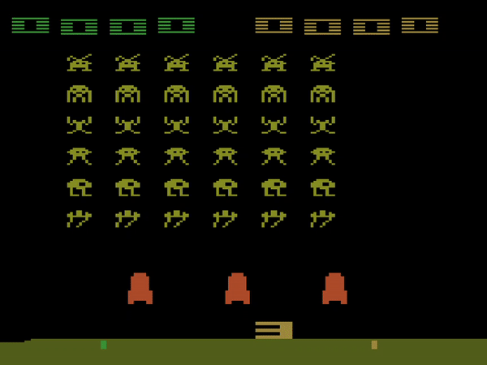
Agenda
Introduction
Reinforced Learning
Technical Details
First Steps

Slide 3
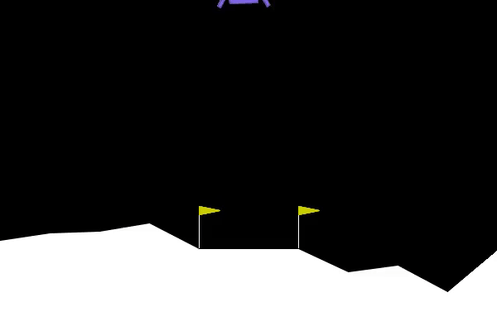
Introduction
Innovation
Application
Limitations
Ethics
Notes:
Subfield of AI – accessible to non experts – user friendly interfaces
Interactive Interfaces – feedback and guidance – Interpretability
Image & speech recognition – NLP – Predictive modeling
Easy to use, but not as accurate or powerful – quality dependent on data
Abuse of models – misuse of knowledge

Slide 4
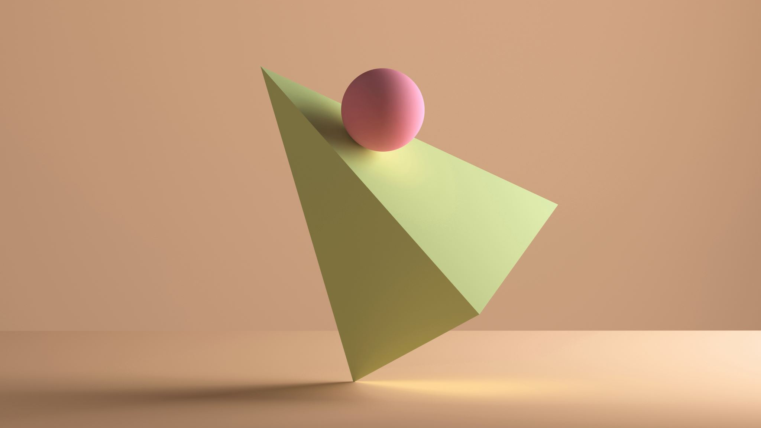
Reinforced learning
Teachable ML
Benefits & Challenges
Notes:
Model makes decision in environment
Take actions to maximize reward
Trial and error
Good at playing games
Can be trained to take actions in the real world
Unsupervised learning – not a lot of external data required
Long training time, computationally intensive
Hard to design reward function
Unpredictable results as it learned from trial and error

Slide 5
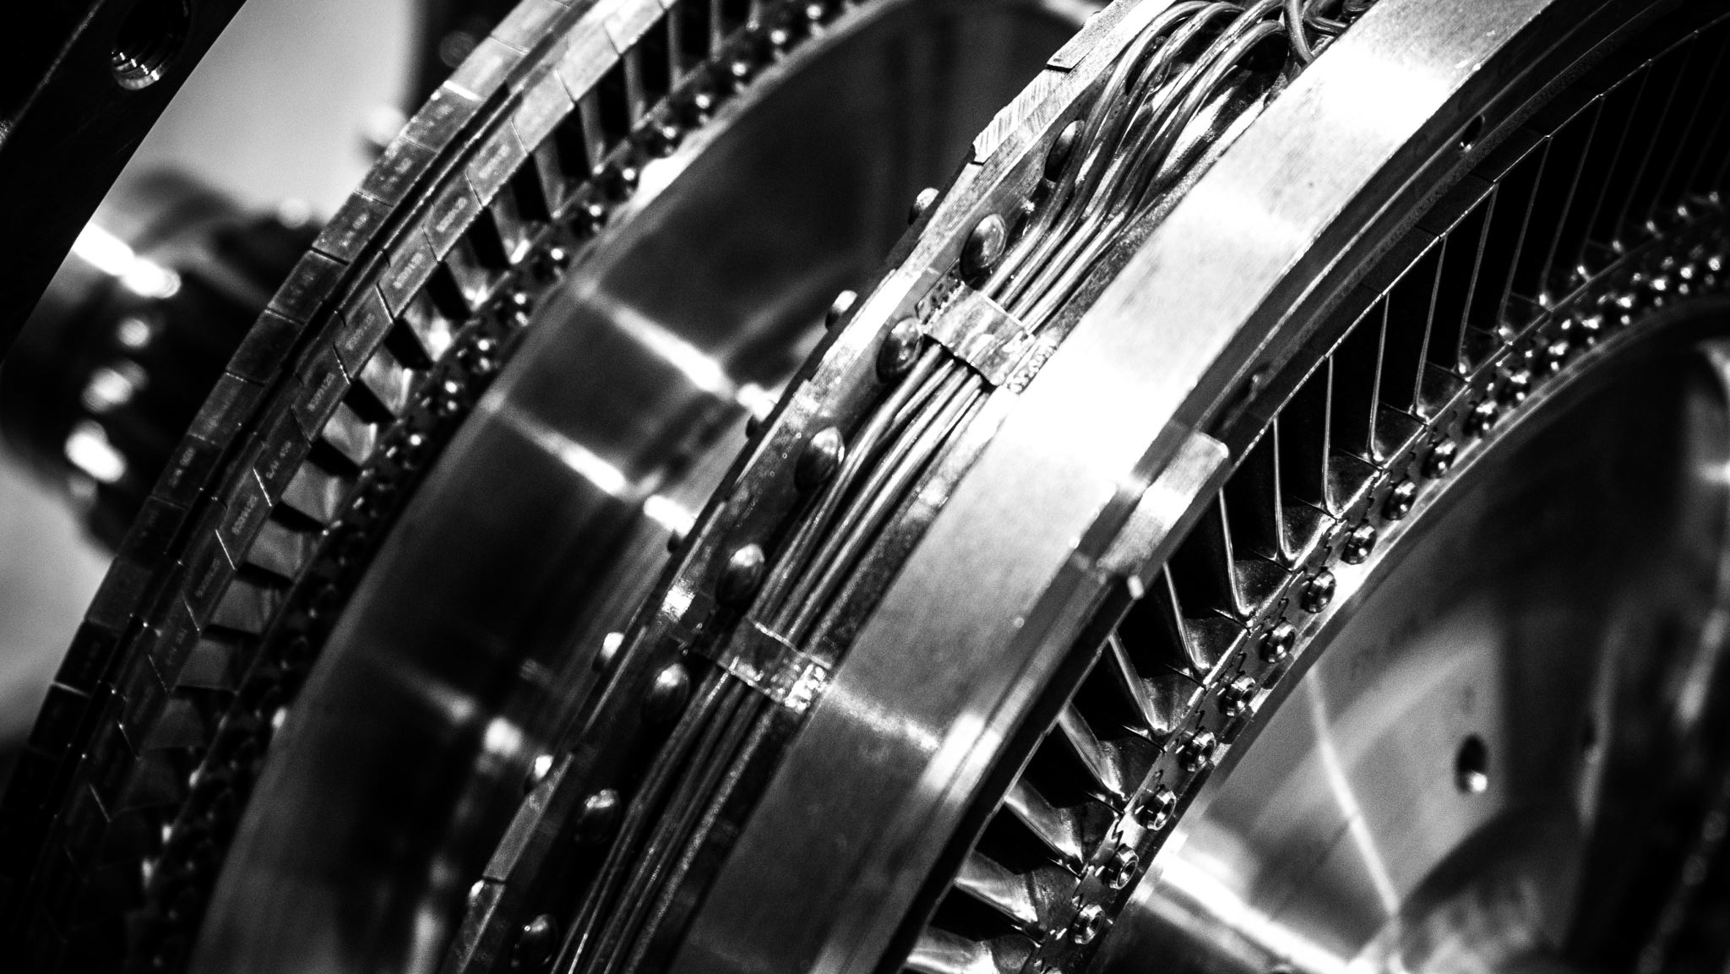
Technical Details
Teachable ML
Terminology – Results – Algorithms - Environments

Slide 6
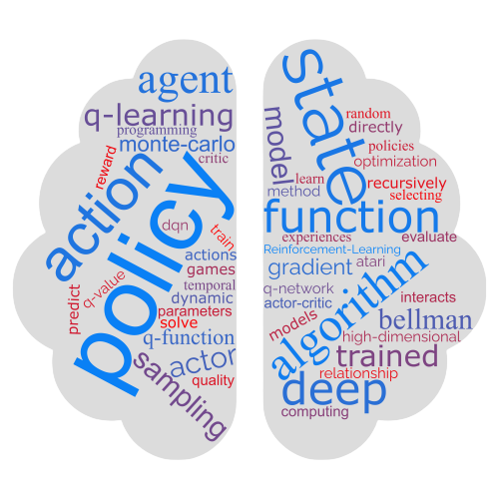
Terminology
Teachable ML
Notes:
- Agent – Environment – State – Action – Reward – Policy – Value Function

Slide 7

Result Driven
Value Function
Optimal Policy
State, Action, Reward
Notes:
Vfunc to evaluate the quality of different states and actions
Iteratively update Vfunc

Slide 8
Algorithms
Dynamic Programming
Policy Gradient Methods (PPO)
Monte Carlo Methods
Temporal Difference Learning
Actor-Critic Methods
Q-Learning
Deep Q-Learning (DQN)
Dueling Deep Q-Learning (DDQN)

Slide 9
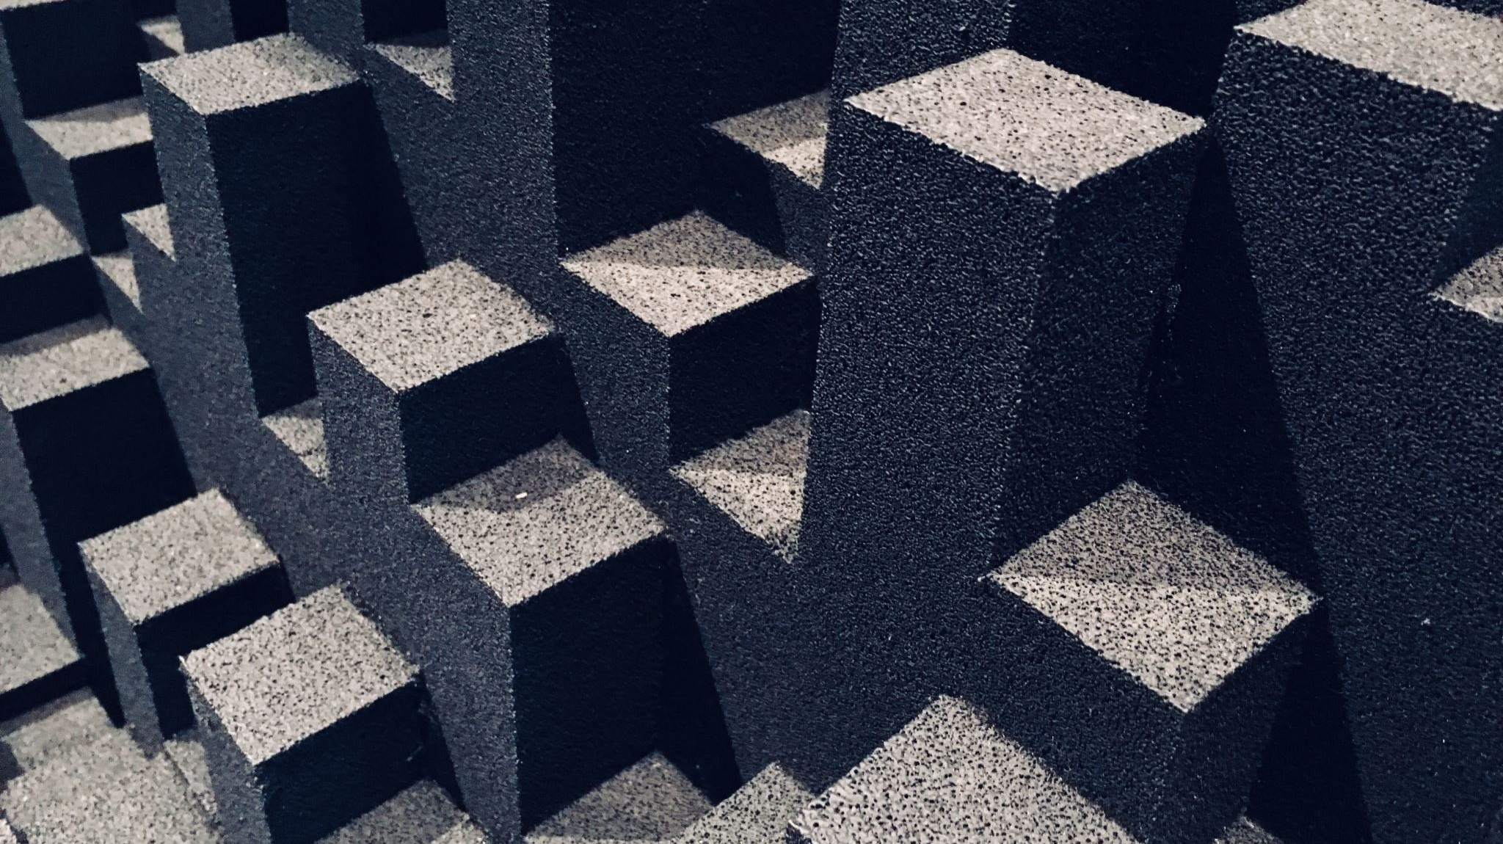
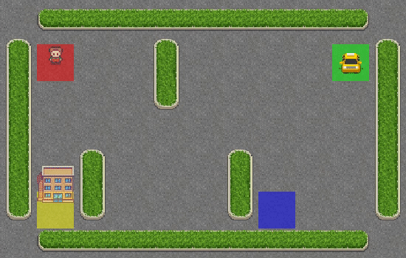
Environments
Simulated – Video Games – Robotics
Teachable ML
Notes:
- Choice depends on goals and interests

Slide 10
Preliminary Results
OpenAI Gym Environments
Actor Training
Model Evaluation
Notes:
Created various algorithm and trained models in several environments
- Experimenting with parameters for model evaluation

Slide 11
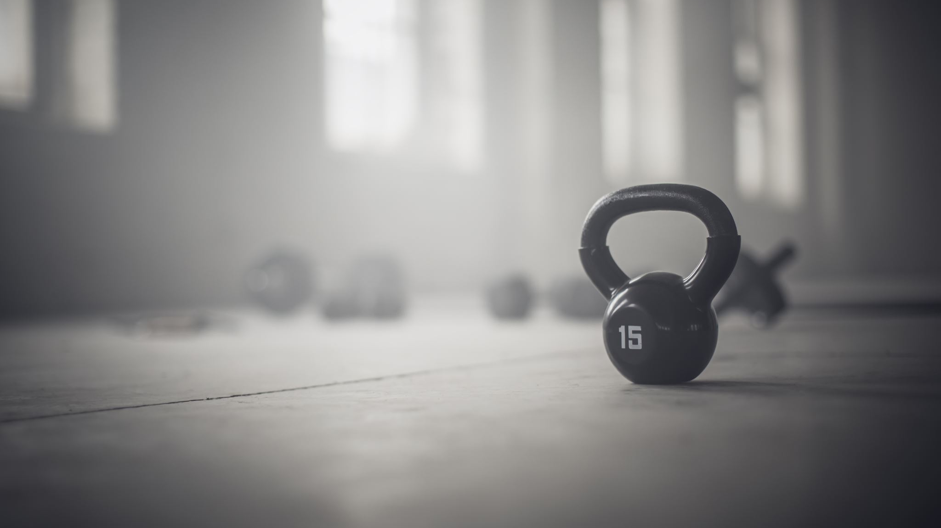
Dynamic Training &Teaching
OpenAI Gym Interfacing
Difficulties
Teaching Methodology
Notes:
Gym interface is quite static
Long training time
No real time adjustments
Planning a teaching methodology

Slide 12
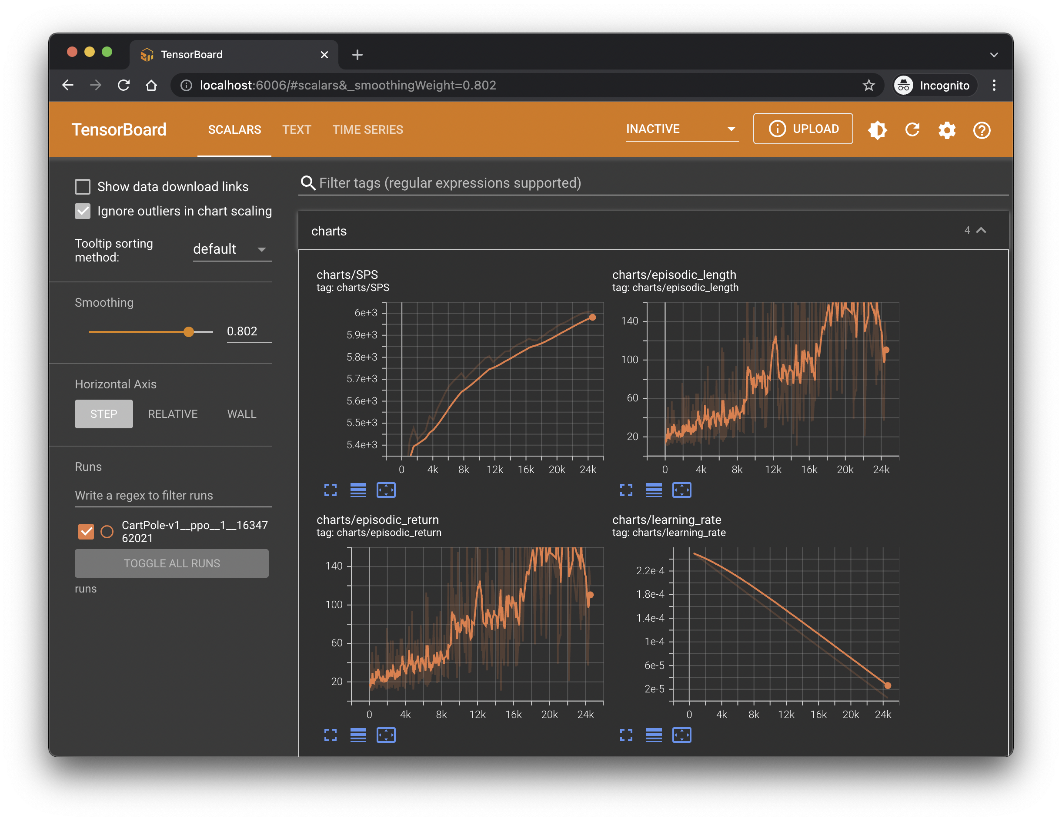
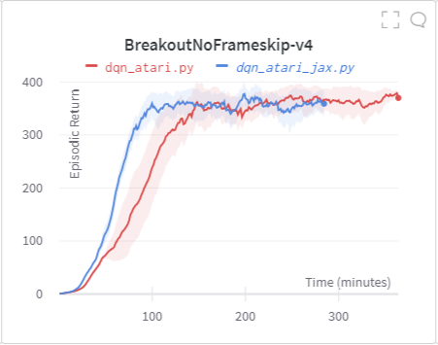
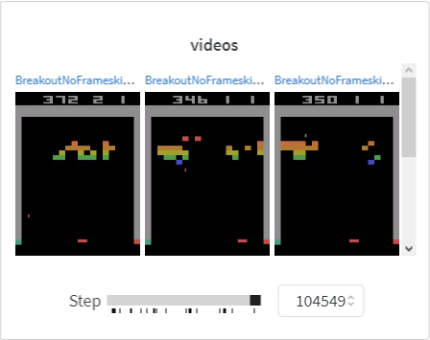
Next Steps
Fast Training Models
Tensor-board Integration
Visualize Training
Hyperparameter Tuning
From CLI to PyGUI

Slide 13
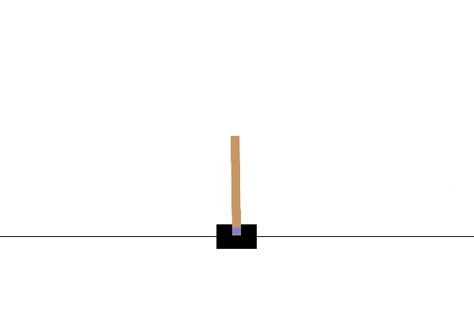
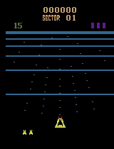
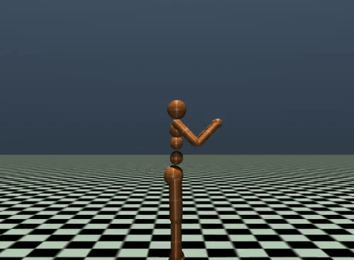
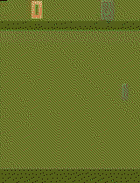
Thank you
Mateusz Mierzejek
imattdesign@gmail.com
imatt.space

